Slide 1
Moody Grading Data Puzzle
Akshaj Kammari

Slide 2
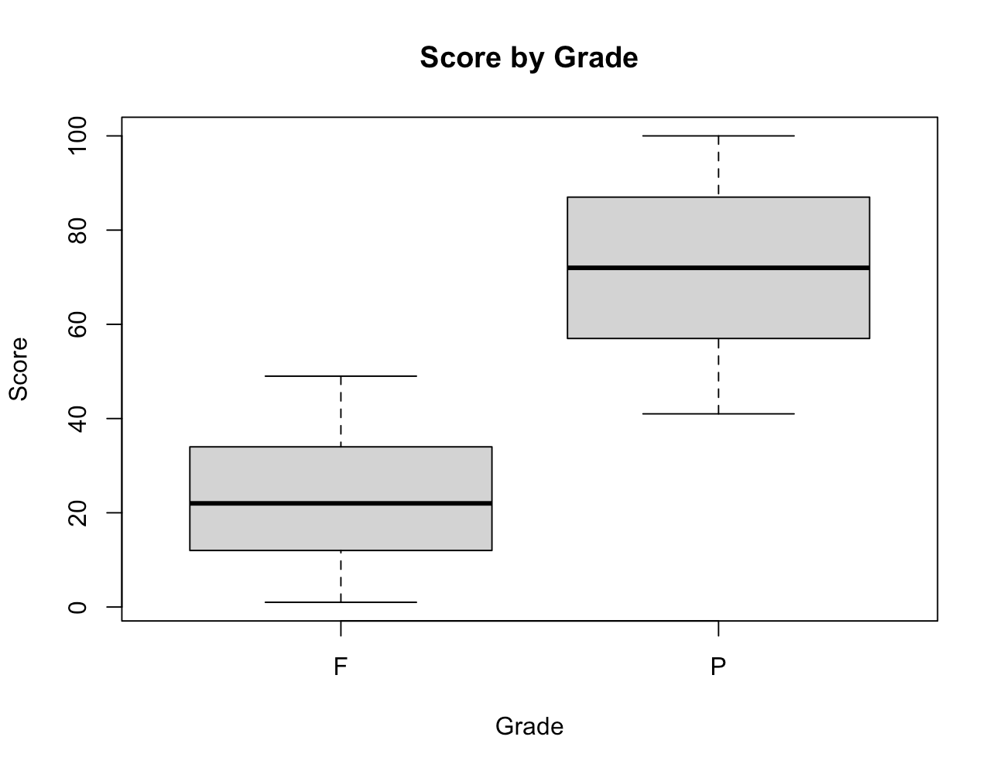
Score
The most obvious/direct factor involved in a students grade is their score in the class, as was mentioned in the assignment breakdown. The general trend is that students with higher scores pass and those with lower fail. But if we look closely, there are outliers in both the students who pass and fail, and they cross each other; there is a student who passes with a score of 41, and 2 student who fail with a score of 49. How could this be. To find out, we must look at other factors involved in Professor Moody’s rule for grading.

Slide 3
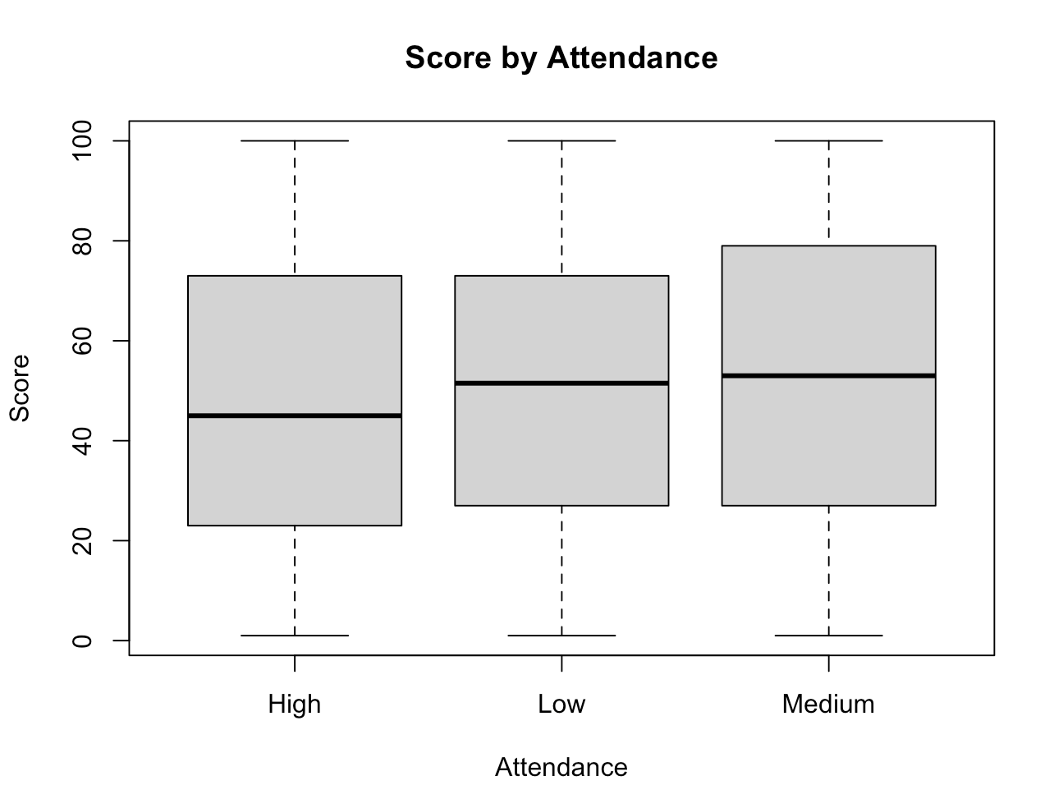
Attendance
Hmmm, interesting. The average score of students with higher attendance, seems to be lower than students with medium attendance, and even low attendance. This contradicted my assumptions, as I thought that attendance in class was important. Not for Professor Moody I suppose.

Slide 4
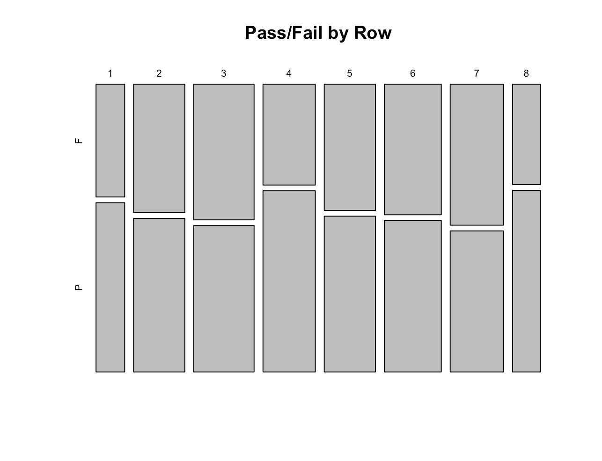
Row
So this would prove it to us further that attendance doesn’t hold too much value. According to this mosaic plot, rows 1, 4, and 8 had the highest percentage of students passing. It seems as if the students are spread throughout the room without any specific pattern. Hence, we can rule out attendance/classroom seating and anything of that nature for good.

Slide 5
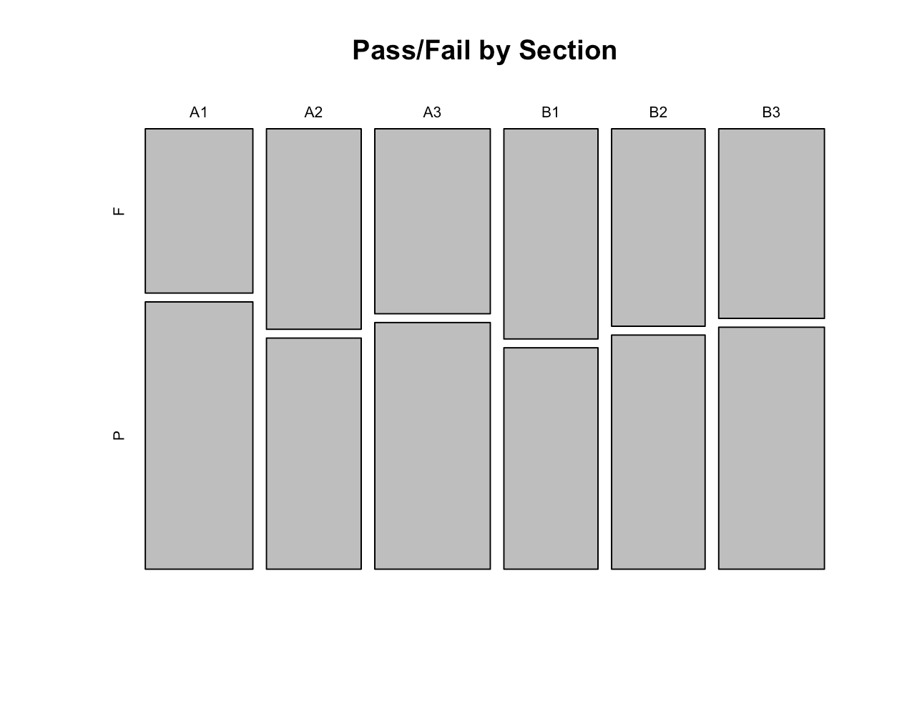
Section
Finally, we can take a look at the mosaic plot for Sections. The sections for A seem to have higher percentages of students passing than the sections for B. Perhaps there is a noticeable discrepancy between teaching assistants for the course, and that going to section A recitations yielded a better learning experience than B did.

Slide 6
Conclusion
How can you pass Professor Moody’s class?
Score has the biggest impact on whether you pass the class or not. But how do you get a good score?
Attendance didn’t seem to have the best correlation with passing, as students with high attendance had a lower average passing rate than those with high attendance. Best to maintain a medium attendance.
If you did go to class, rows 1, 4, and 8 were the places to be. Perhaps if you sat in row one, you were forced to pay attention in front of the professor, and if you sat in 4 or 8 you had a better view of the lecture material?
Sections of A showed the best results. Maybe attend section A’s recitations and hope your assignments get graded by the TA of section A.

